Slide 1
Introduction to R Programming
Ravishankar Rajagopalan
DSG - Data Sciences Engineering
05/12/2016

Slide 2
R - Introduction
Free Open Source programming developed based on S language from Bell Labs
Integrated suite of software for data manipulation, modeling and visualization
Provides a set of packages (base/contributed) meant for various stages of the modeling process:
CRAN Task View: http://cran.r-project.org/web/views/
Installing R: http://cran.r-project.org/mirrors.html

Slide 3
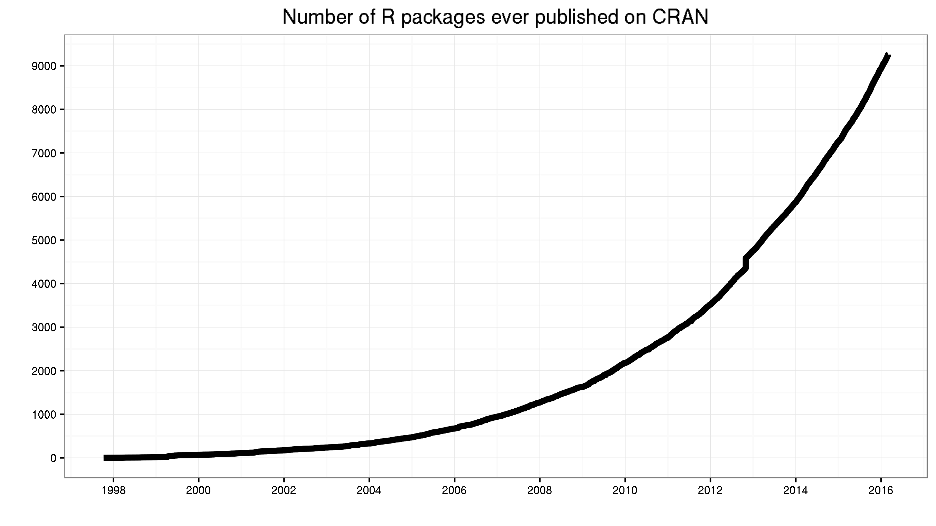
R - Packages

Slide 4
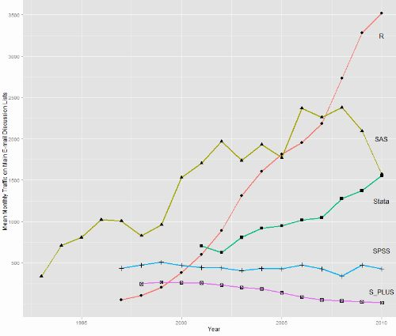
R Vs Other Statistical Software

Slide 5
R - Resources
R Tutorials:
http://www.statmethods.net/ - Quick R
R Discussion Forums:
Stackoverflow - http://stackoverflow.com/questions/tagged/r
Nabble - http://r.789695.n4.nabble.com/
R Blogs:
http://www.r-bloggers.com/
http://blog.revolutionanalytics.com/

Slide 6
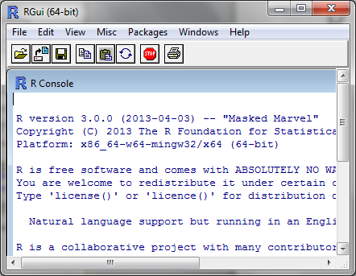
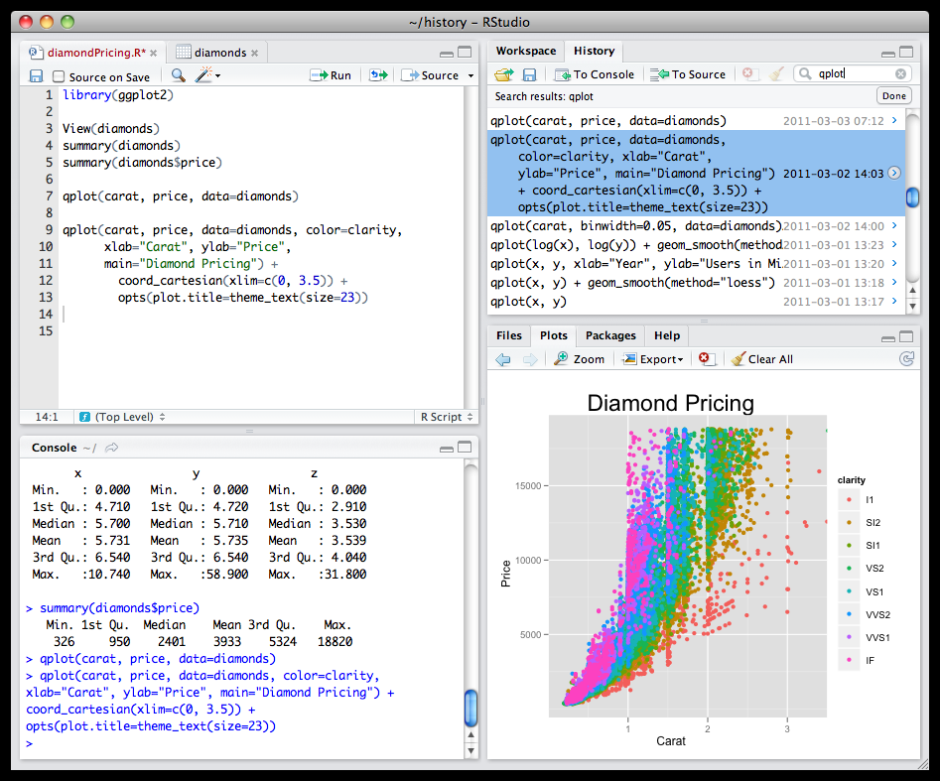
R Development Environment
Default Editor
R Studio IDE
Eclipse + statET plugin
Revolution R ($$$ Commercial $$$)
GUI – Shiny, Rattle

Slide 7
Topics to be covered
Day 1
Section 1: Getting Started with R
Section 2: Data Types in R
Section 3: Data Input/Output
Section 4: Data Manipulation
Section 5: Functions and Control Statements
Day 2
Section 5: Exploratory Data Analysis
Section 6: Statistical Modeling and Data Mining
Section 7: Visualization

